Slide 1
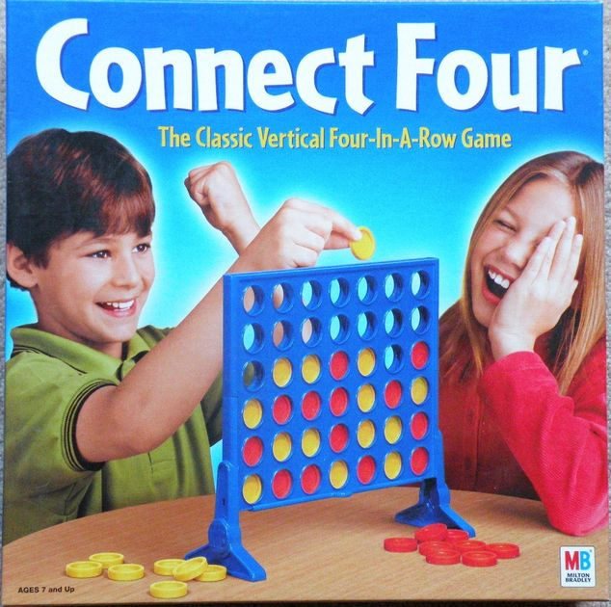
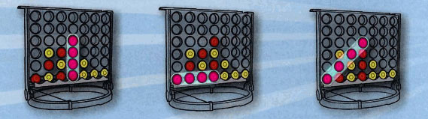
Connect 4
Rules
Take turns dropping pieces to connect 4
Your pieces will fall to the bottom of the board
Your pieces will land on the bottom of the board or another piece.
You can win by connecting 4:
Play
Exit
Vertically Horizontally Diagonally

Slide 2
Somebody wins
drop
drop
drop
drop
drop
drop
drop
Red player’s turn
Exit

Slide 3
drop
drop
drop
drop
drop
drop
drop
Red player’s turn
Red Wins!
Play Again
Main Menu
Exit
Exit

